Slide 1
Research Presentation
Aryan Ritwajeet Jha
Graduate Research Assistant
Washington State University
Notes:
Remember to hit the reset button to make sure all the page elements react properly.
There are 20 different layouts that you can choose from.

Slide 2

Scalable Multi-Period Optimal Power Flow for Active Power Distribution Systems
Washington State University
August $2022$ onwards
Notes:
Remember to hit the reset button to make sure all the page elements react properly.
There are 20 different layouts that you can choose from.

Slide 3

Multi-Period D-OPF simulation of a grid with DERs and Battery Storage

Slide 4
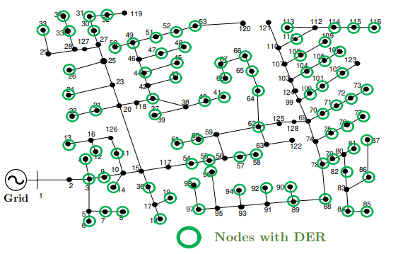
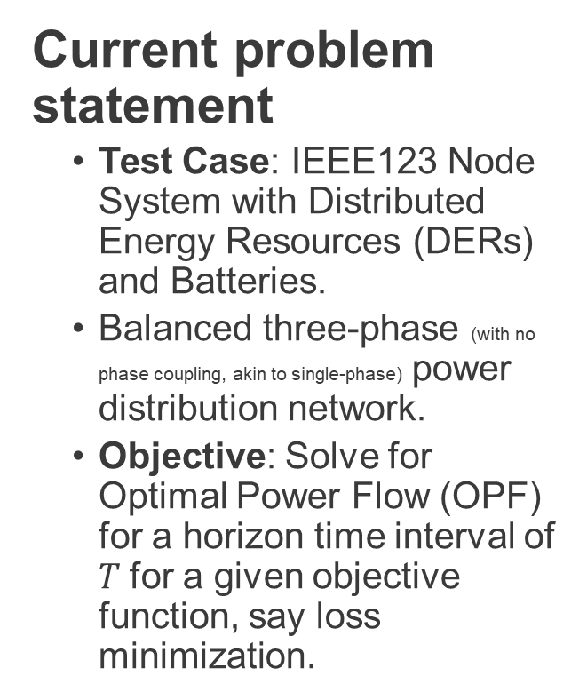
Network being tested on
Current problem statement
Test Case: IEEE123 Node System with Distributed Energy Resources (DERs) and Batteries.
Balanced three-phase (with no phase coupling, akin to single-phase) power distribution network.
Objective: Solve for Optimal Power Flow (OPF) for a horizon time interval of $T$for a given objective function, say loss minimization.

Slide 5
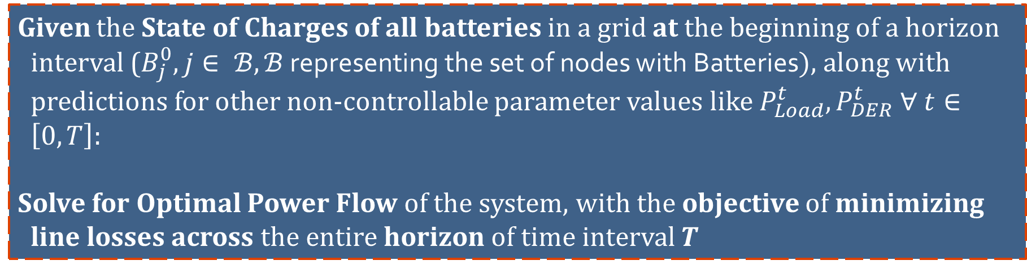
Problem Statement
Given the State of Charges of all batteries in a grid at the beginning of a horizon interval ($B_{j}^{0}, j∈ ℬ, ℬ$ representing the set of nodes with Batteries$)$, along with predictions for other non-controllable parameter values like $P_{Load}^{t}, P_{DER}^{t} ∀ t∈\left[0, T\right]$:
Solve for Optimal Power Flow of the system, with the objective of minimizing line losses across the entire horizon of time interval $T$

Slide 6
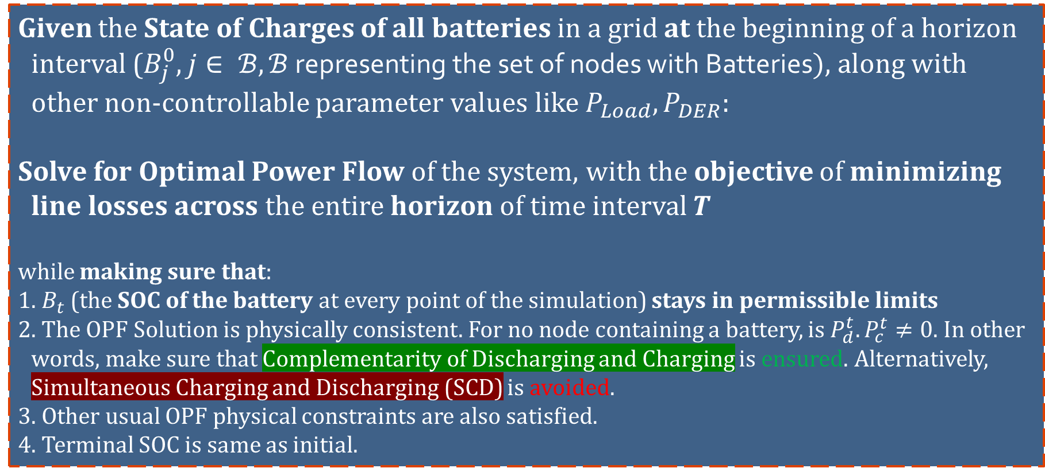
Problem Statement
Given the State of Charges of all batteries in a grid at the beginning of a horizon interval ($B_{j}^{0}, j∈ ℬ, ℬ$ representing the set of nodes with Batteries$)$, along with other non-controllable parameter values like $P_{Load}, P_{DER}$:
Solve for Optimal Power Flow of the system, with the objective of minimizing line losses across the entire horizon of time interval $T$
while making sure that:
1. $B_{t}$ (the SOC of the battery at every point of the simulation) stays in permissible limits
2. The OPF Solution is physically consistent. For no node containing a battery, is $P_{d}^{t}. P_{c}^{t}≠0$. In other words, make sure that Complementarity of Discharging and Charging is ensured. Alternatively, Simultaneous Charging and Discharging (SCD) is avoided.
3. Other usual OPF physical constraints are also satisfied.
4. Terminal SOC is same as initial.

Slide 7
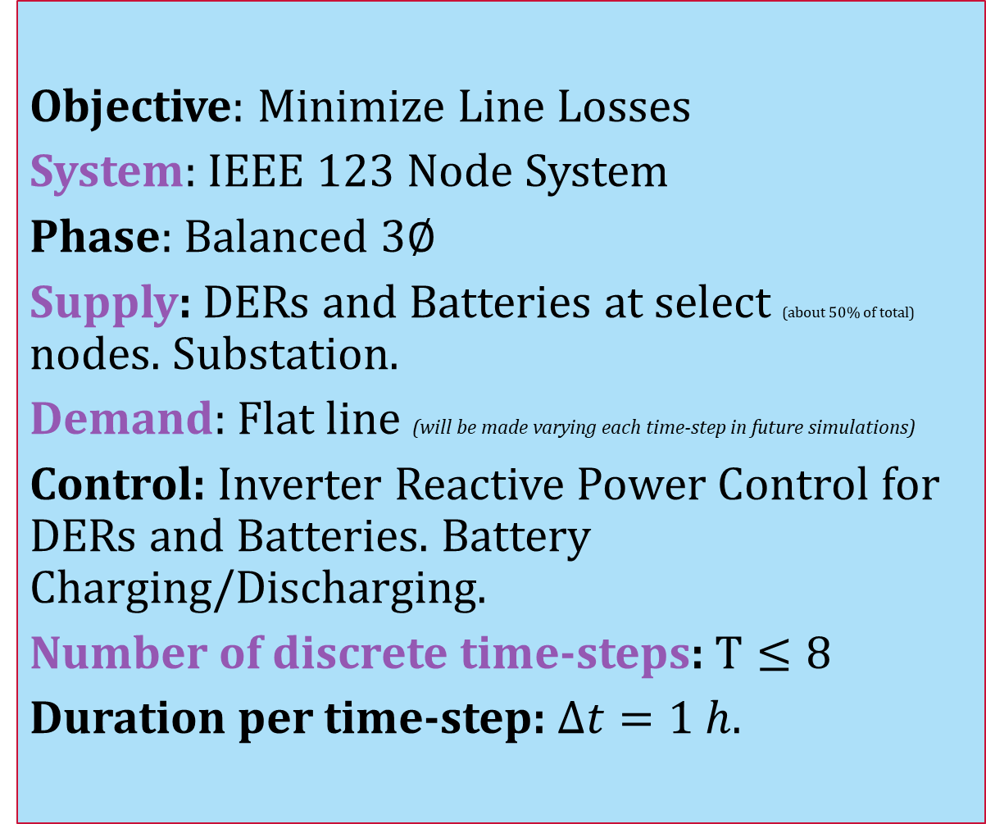
Simulation Parameters
Objective: Minimize Line Losses
System: IEEE $123$ Node System
Phase: Balanced $3∅$
Supply: DERs and Batteries at select (about $50\%$ of total) nodes. Substation.
Demand: Flat line (will be made varying each time-step in future simulations)
Control: Inverter Reactive Power Control for DERs and Batteries. Battery Charging/Discharging.
Number of discrete time-steps: $T≤8$
Duration per time-step: $Δt=1 h$.

Slide 8
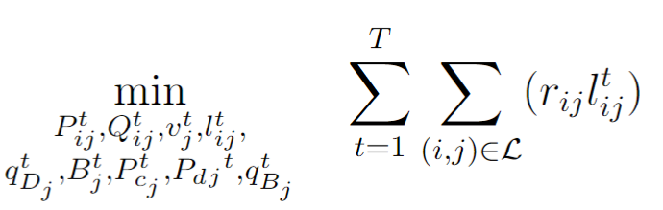
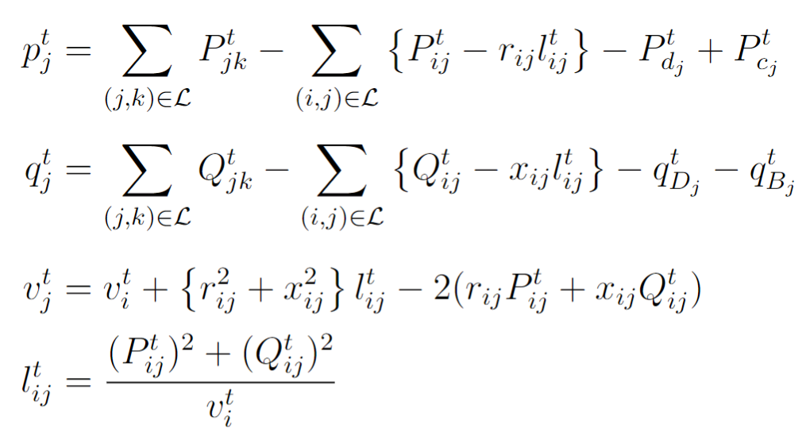
Optimization Formulation
(Integer-Constraint Relaxed) Non-linear Optimization Problem: BFM Constraints with Battery and DER decision variables.
Line Losses
Real Powerflow from a bus into the network
Reactive Powerflow from a bus into the network
Kirchhoff's Voltage Law (KVL)
Current Magnitude in a branch

Slide 9
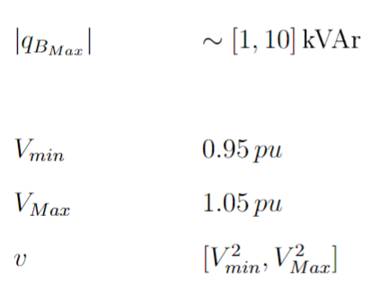
Optimization Formulation
(Integer-Constraint Relaxed) Non-linear Optimization Problem: BFM Constraints with Battery and DER decision variables.
Line Losses
DER Inverter Reactive Power
Nodal Voltage Limits

Slide 10
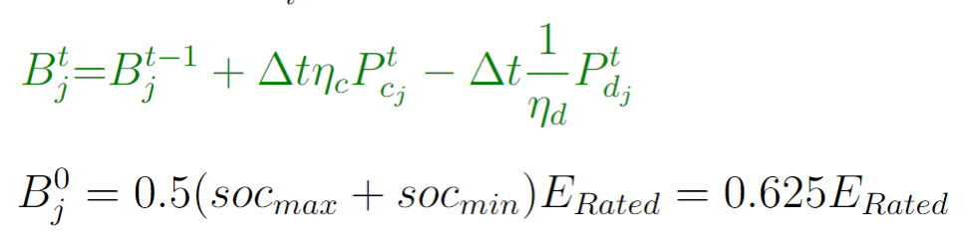
Optimization Formulation
(Integer-Constraint Relaxed) Non-linear Optimization Problem: BFM Constraints with Battery and DER decision variables.
Line Losses
Battery State of Charge Equation (this equation is temporally coupled, or has ‘memory’)

Slide 11
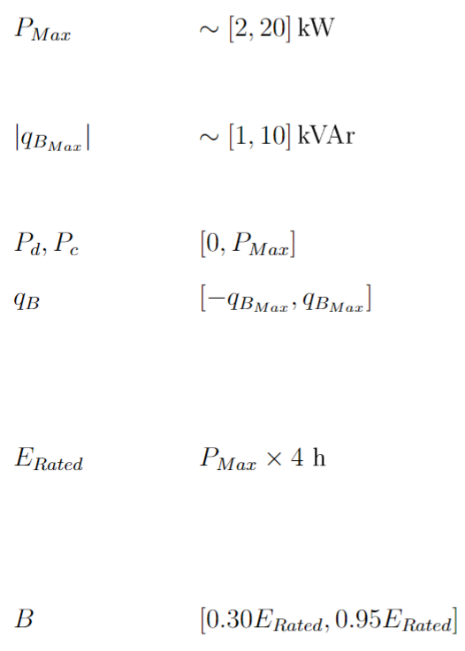
Optimization Formulation
(Integer-Constraint Relaxed) Non-linear Optimization Problem: BFM Constraints with Battery and DER decision variables.
Line Losses
Battery Charging and Discharging Power Limits
Battery Inverter Reactive Power Limits
Battery SOC Permissible Limits

Slide 12
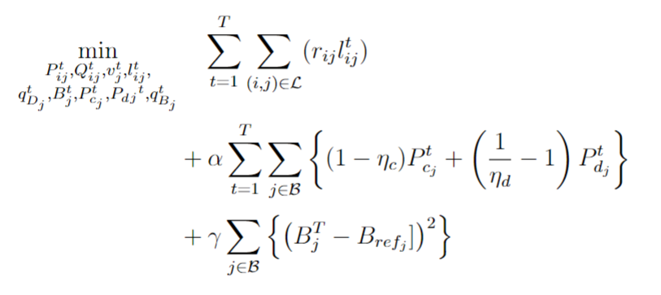
Optimization Formulation
(Integer-Constraint Relaxed) Non-linear Optimization Problem: Tweaking the Objective Function to satisfy some more constraints.
Line Losses
Ensures Complementarity of Charging and Discharging, or alternatively, ensure there’s no SCD.
For minimizing the deviation between end-of-day battery SOC and a reference SOC.

Slide 13
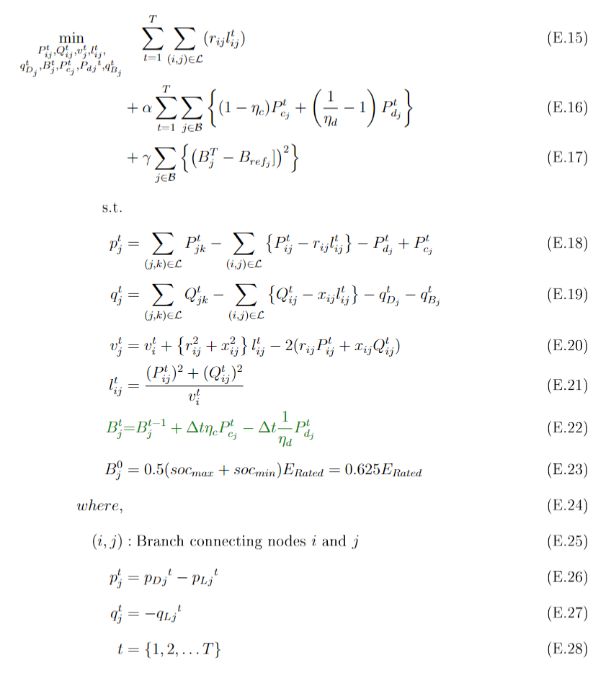
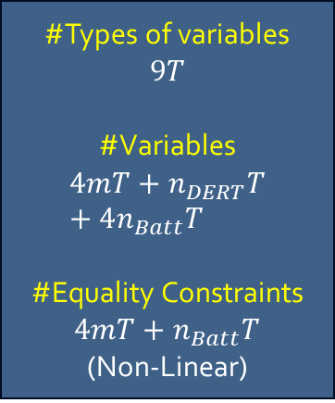
Optimization Formulation
(Integer-Constraint Relaxed) The Full Non-linear Optimization Problem
Line Losses
For minimizing the deviation between end-of-day battery SOC and a reference SOC.
Ensures Complementarity of Charging and Discharging, or alternatively, ensure there’s no SCD.
Real Powerflow from a bus into the network
Battery State of Charge Equation (temporally coupled) with complementarity relaxed.
Reactive Powerflow from a bus into the network
#Types of variables
$$9T$$
#Variables
$$4mT+n_{DERT}T+4n_{Batt}T$$
#Equality Constraints $4mT+n_{Batt}T$
(Non-Linear)
Kirchhoff's Voltage Law (KVL)
Current Magnitude in a branch
DER Generation (forecasted, non-controllable)
Loads (forecasted, non-controllable)

Slide 14
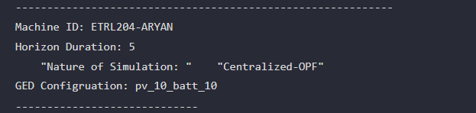
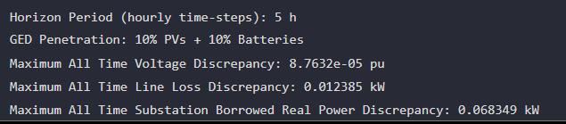
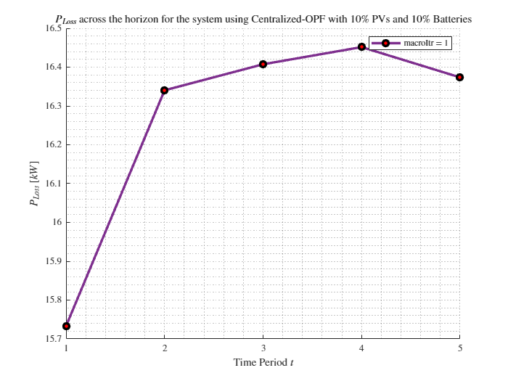
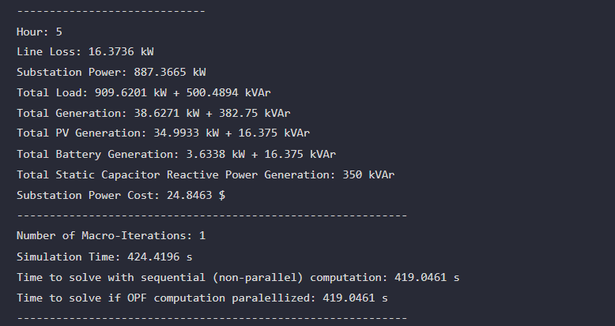

$$T=5, PV=10\%, Batt=10\%$$

Slide 15
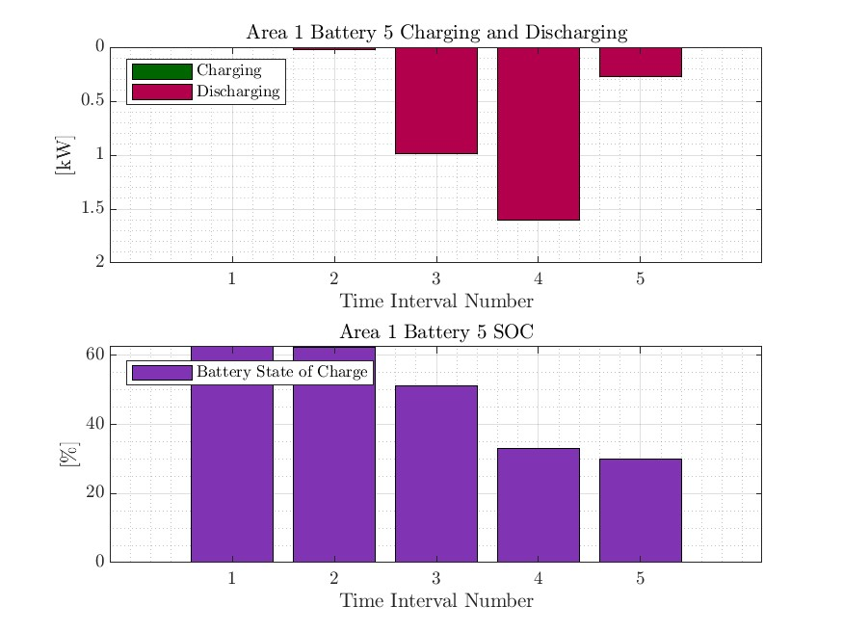
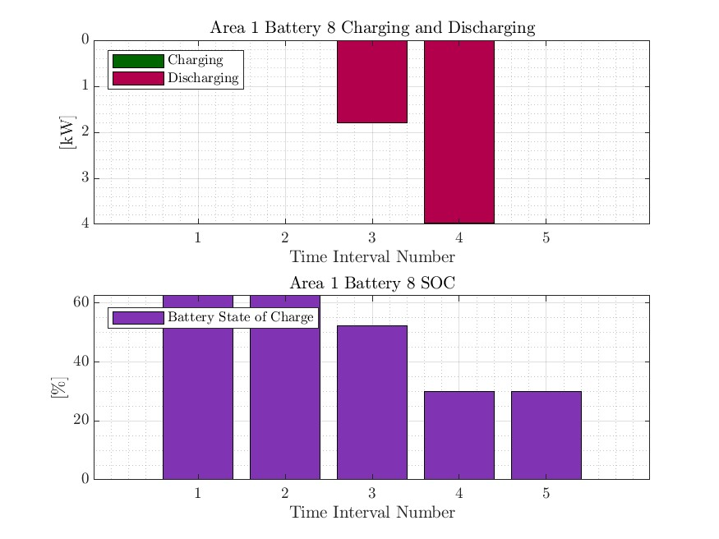
$$T=5, PV=10\%, Batt=10\%$$

Slide 16
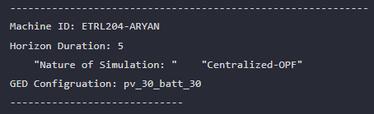
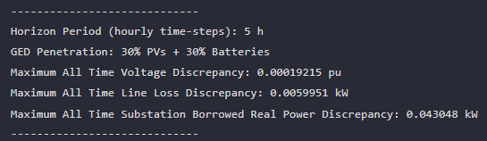
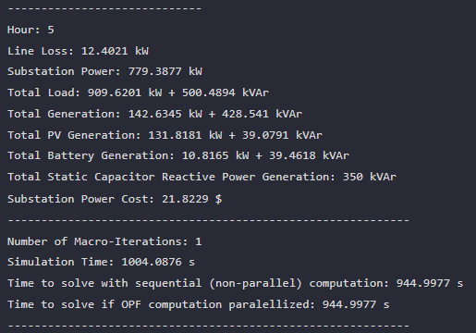
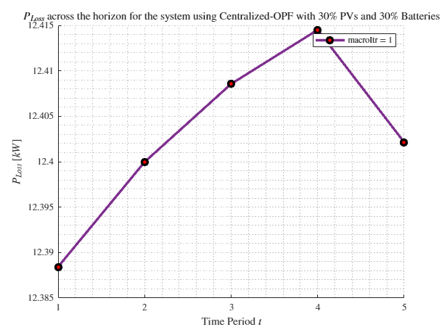

$$T=5, PV=30\%, Batt=30\%$$

Slide 17
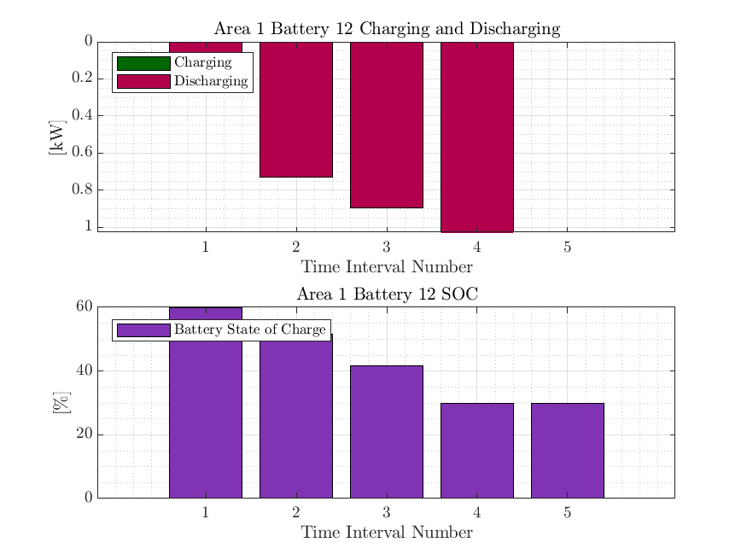
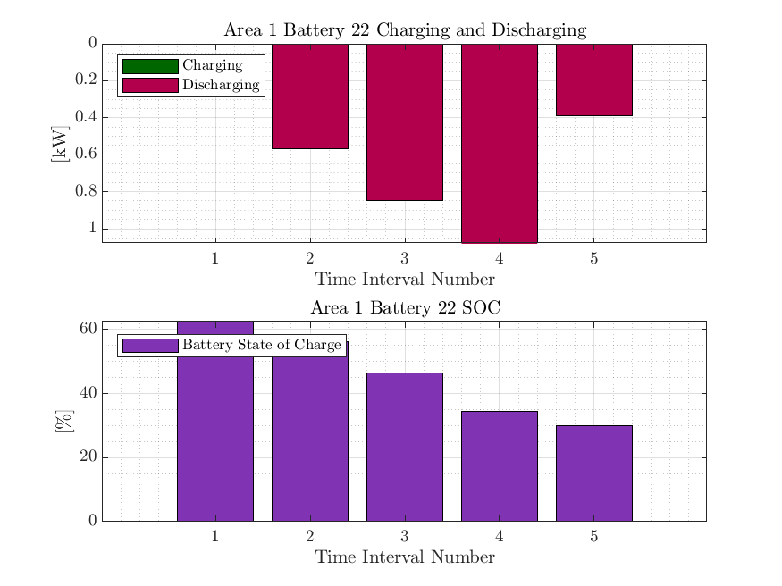
$$T=5, PV=30\%, Batt=30\%$$

Slide 18
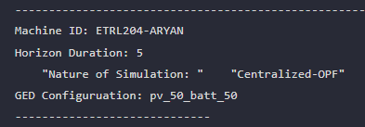
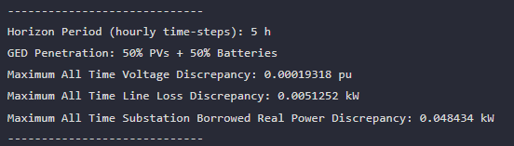
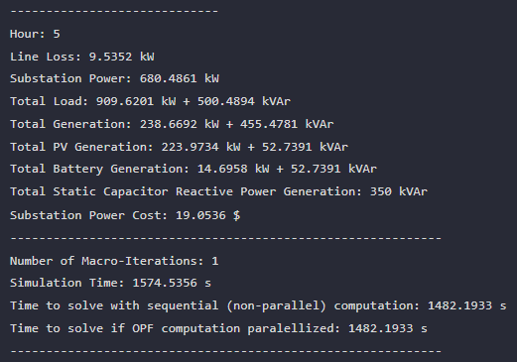
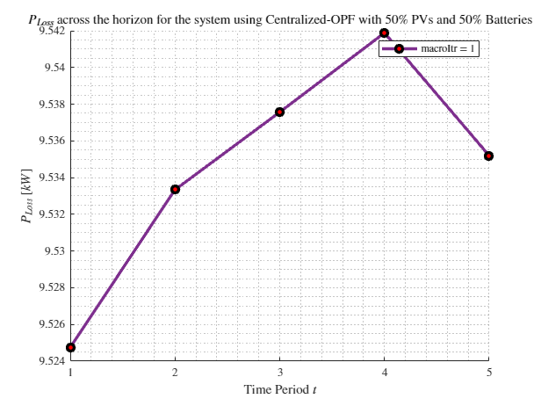

$$T=5, PV=50\%, Batt=50\%$$ sim terminated at 100 micro-iterations

Slide 19
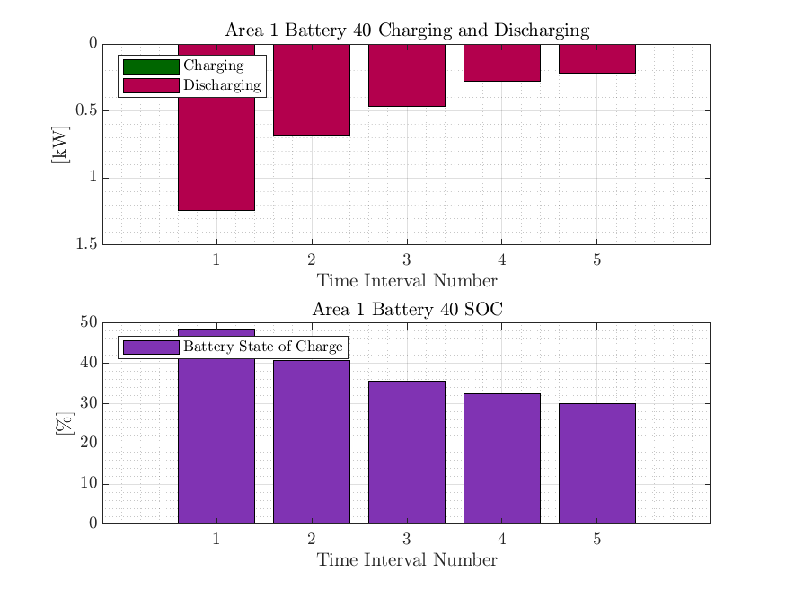
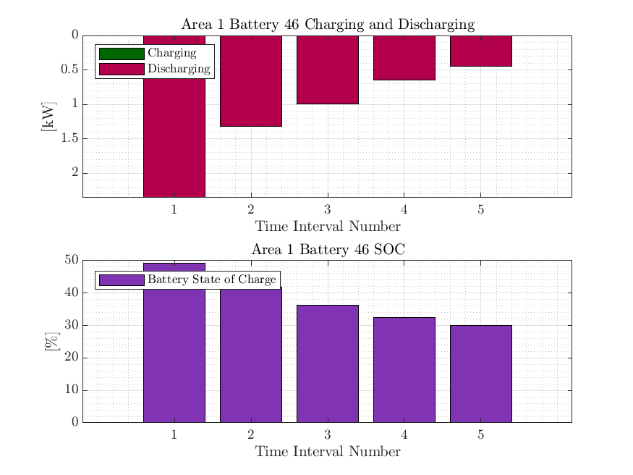
$$T=5, PV=50\%, Batt=50\%$$ sim terminated at 100 micro-iterations

Slide 20
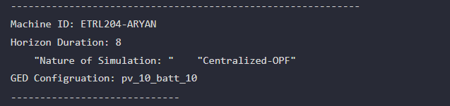
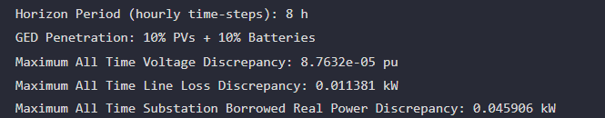
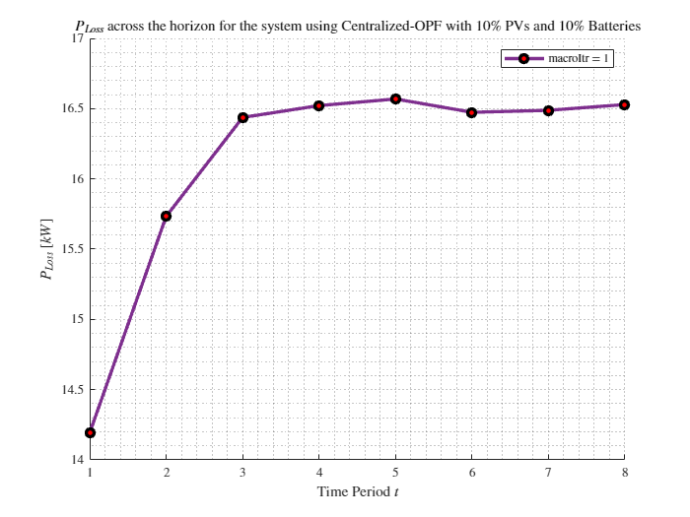
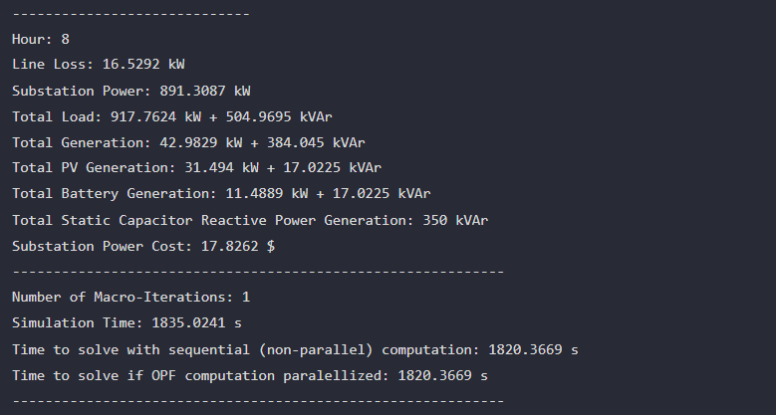

$$T=8,PV=10\%, Batt=10\%$$

Slide 21
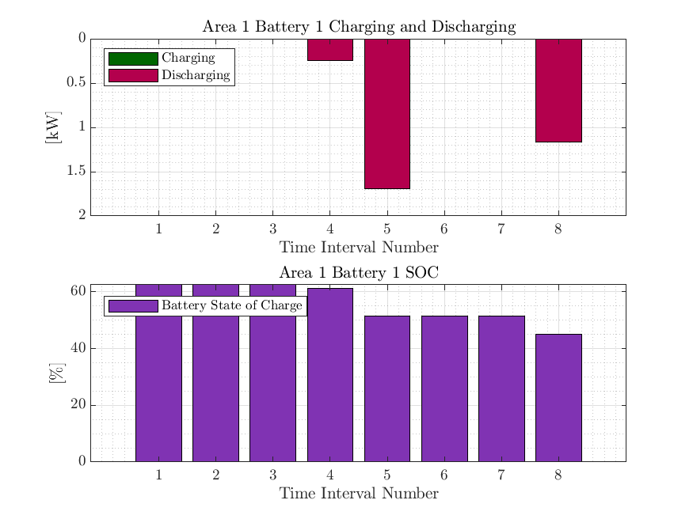
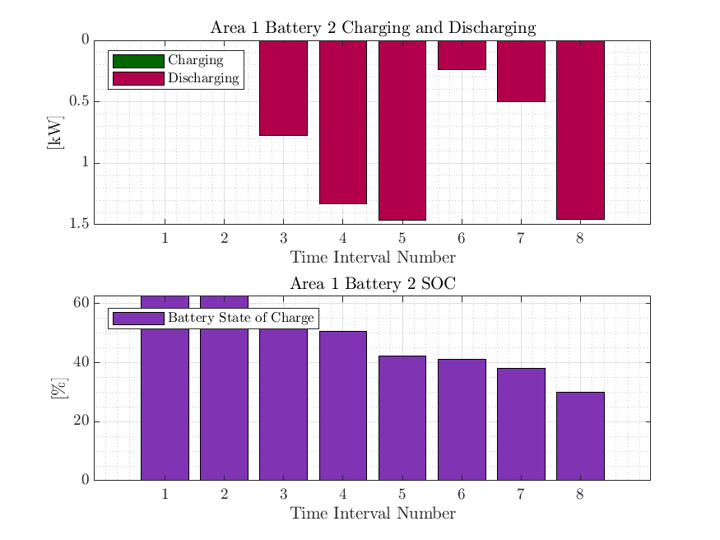
$$T=8,PV=10\%, Batt=10\%$$

Slide 22
Algorithm Development for Spatially Distributing the MPOPF Computation to make it an MPDOPF Computation

Slide 23
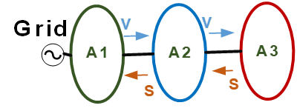
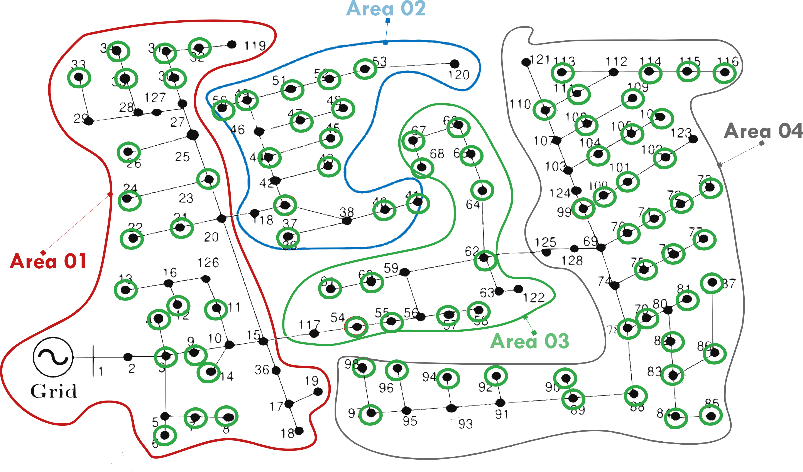

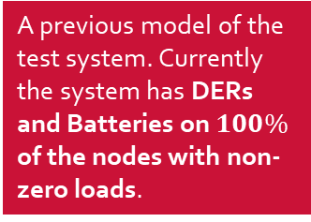
Network being tested on
A previous model of the test system. Currently the system has DERs and Batteries on $100\%$ of the nodes with non-zero loads.
ENApp Approach [1]
Divide the network into several areas to solve for their Optimal Power Flow solutions separately, with exchange of boundary variables after every ‘macro-iteration’.

Slide 24
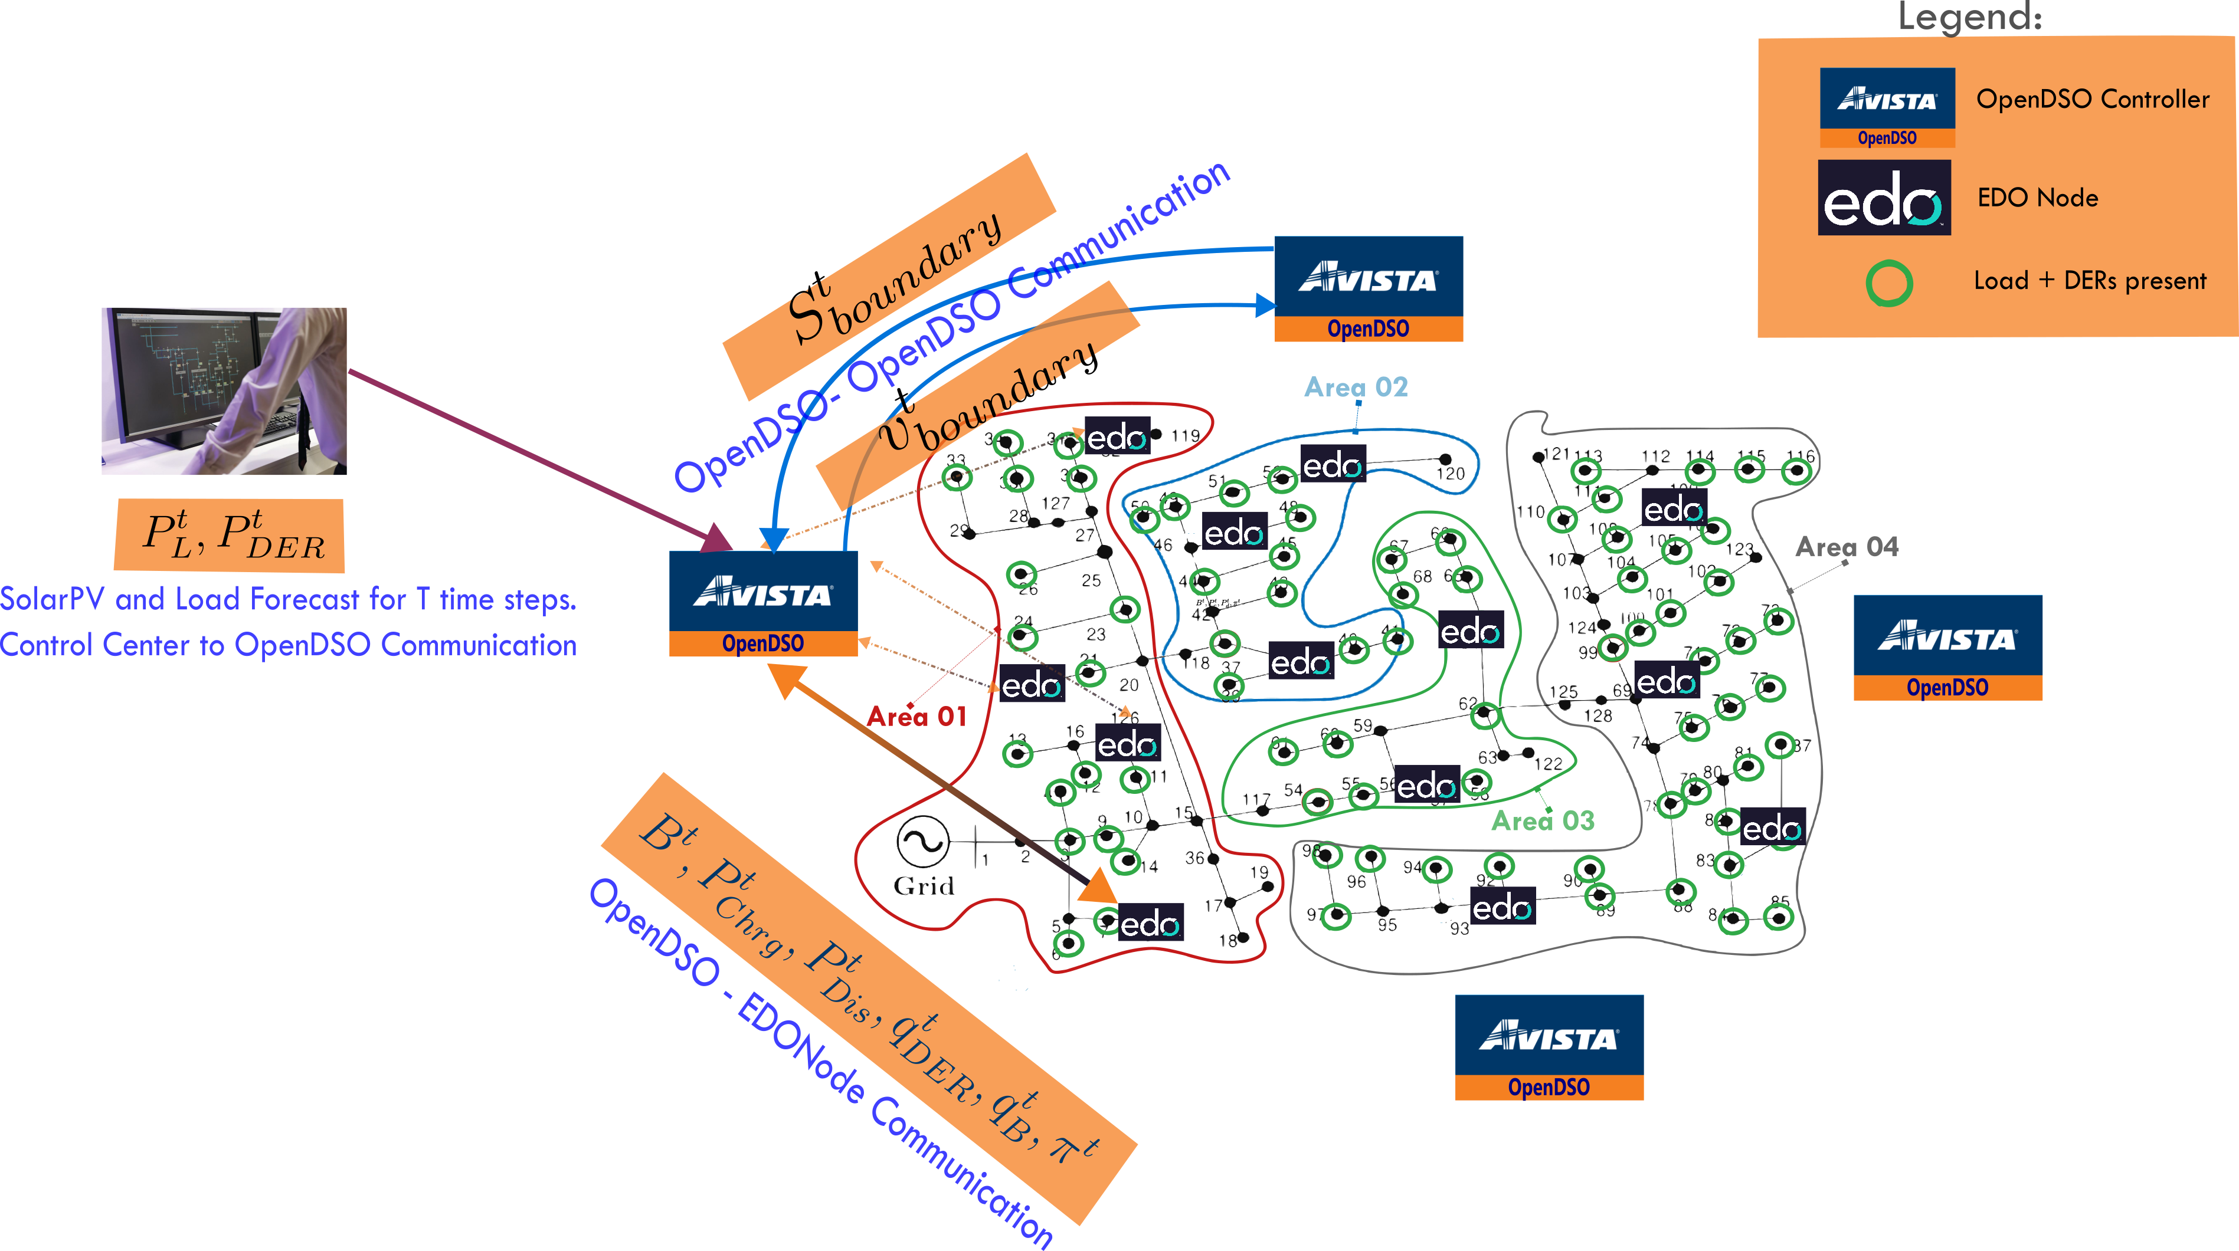
Overall Scope of the problem Algorithm and Communication Architecture
OpenDSO-System Operator (Forecast)
OpenDSO-Measurement Devices
OpenDSO-EDO
OpenDSO-OpenDSO

Slide 25
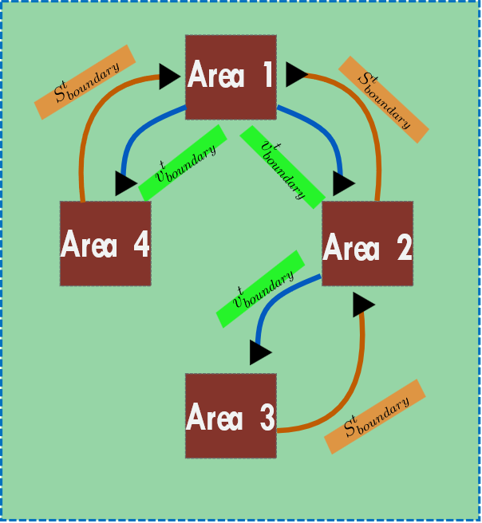
A simpler schematic for D-OPF.

Slide 26
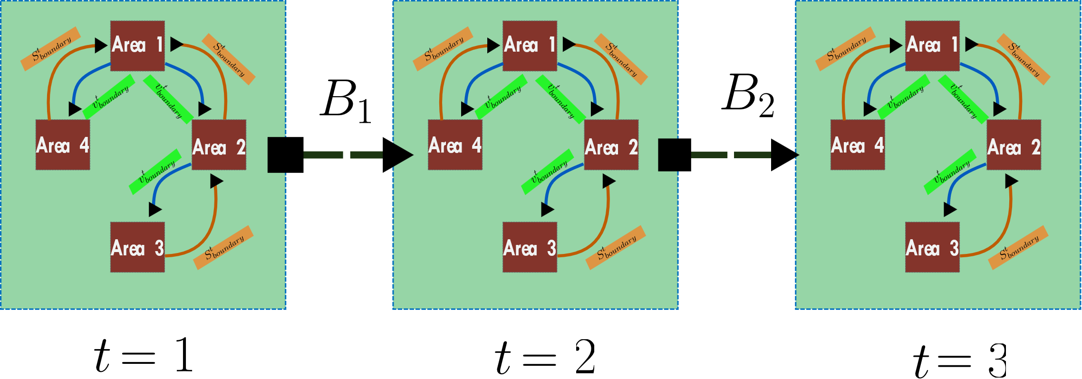
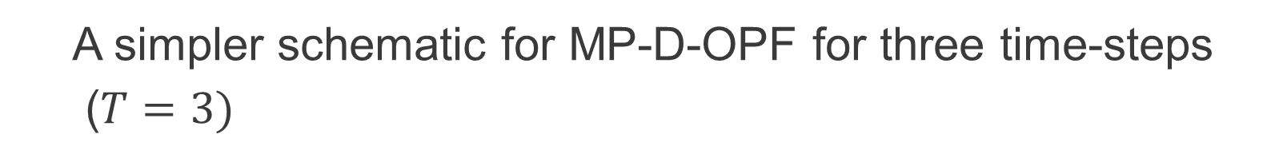
A simpler schematic for MP-D-OPF for three time-steps
($T=3)$

Slide 27
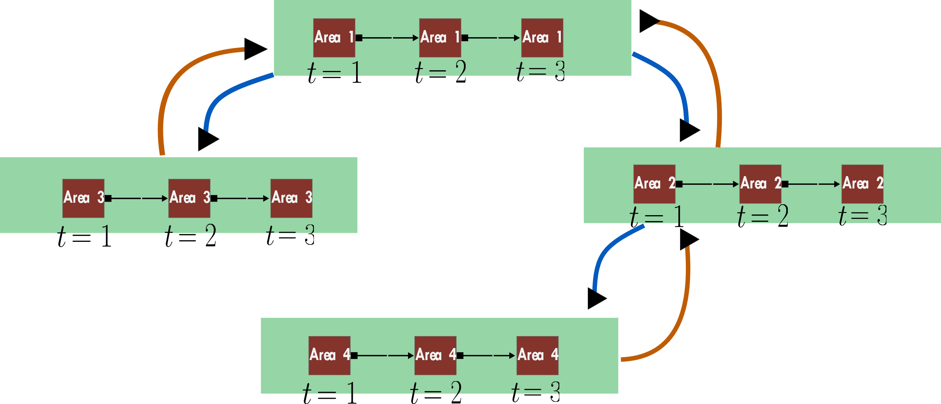
What is currently being done? MP-DOPF in Brute Force

Slide 28

Statistical Analysis for Predicting Instabilities in Power Systems
Indian Institute of Technology Delhi
September $2020$ to August $2022$
Notes:
Remember to hit the reset button to make sure all the page elements react properly.
There are 20 different layouts that you can choose from.

Slide 29
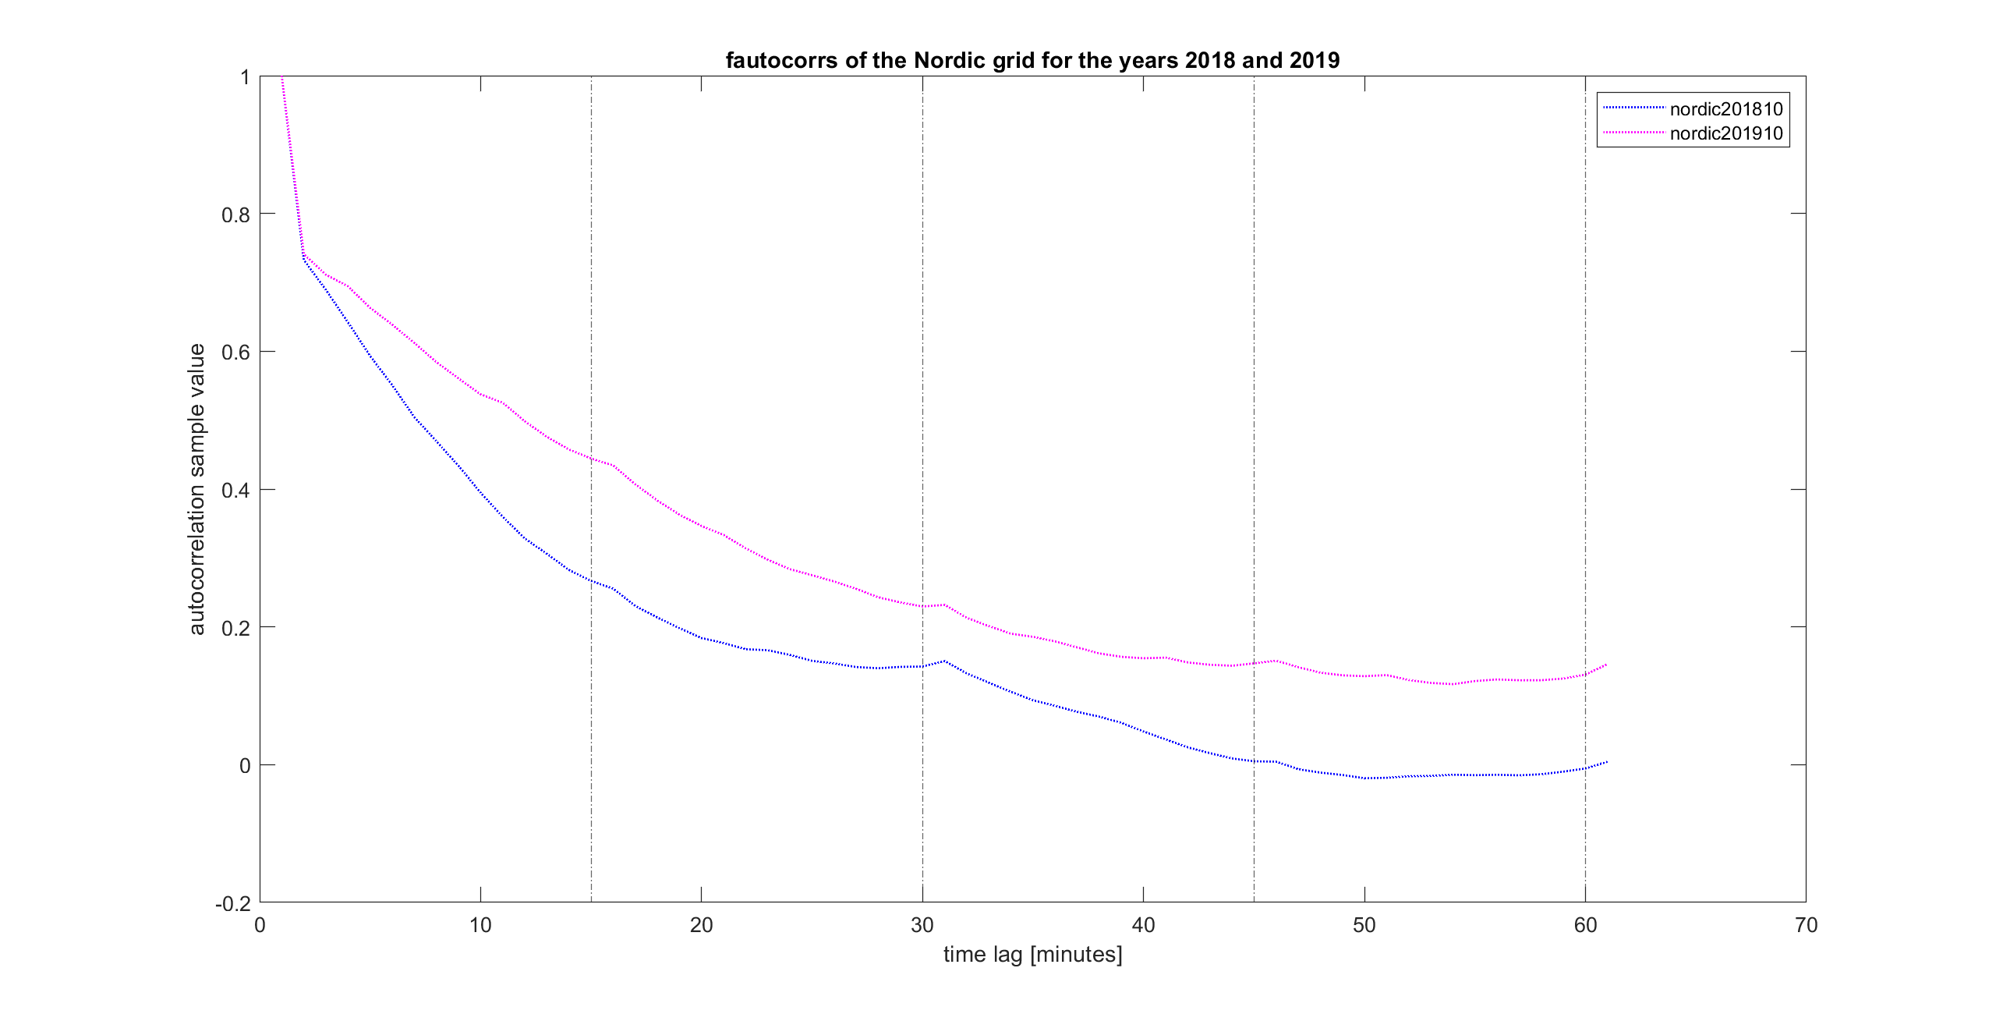
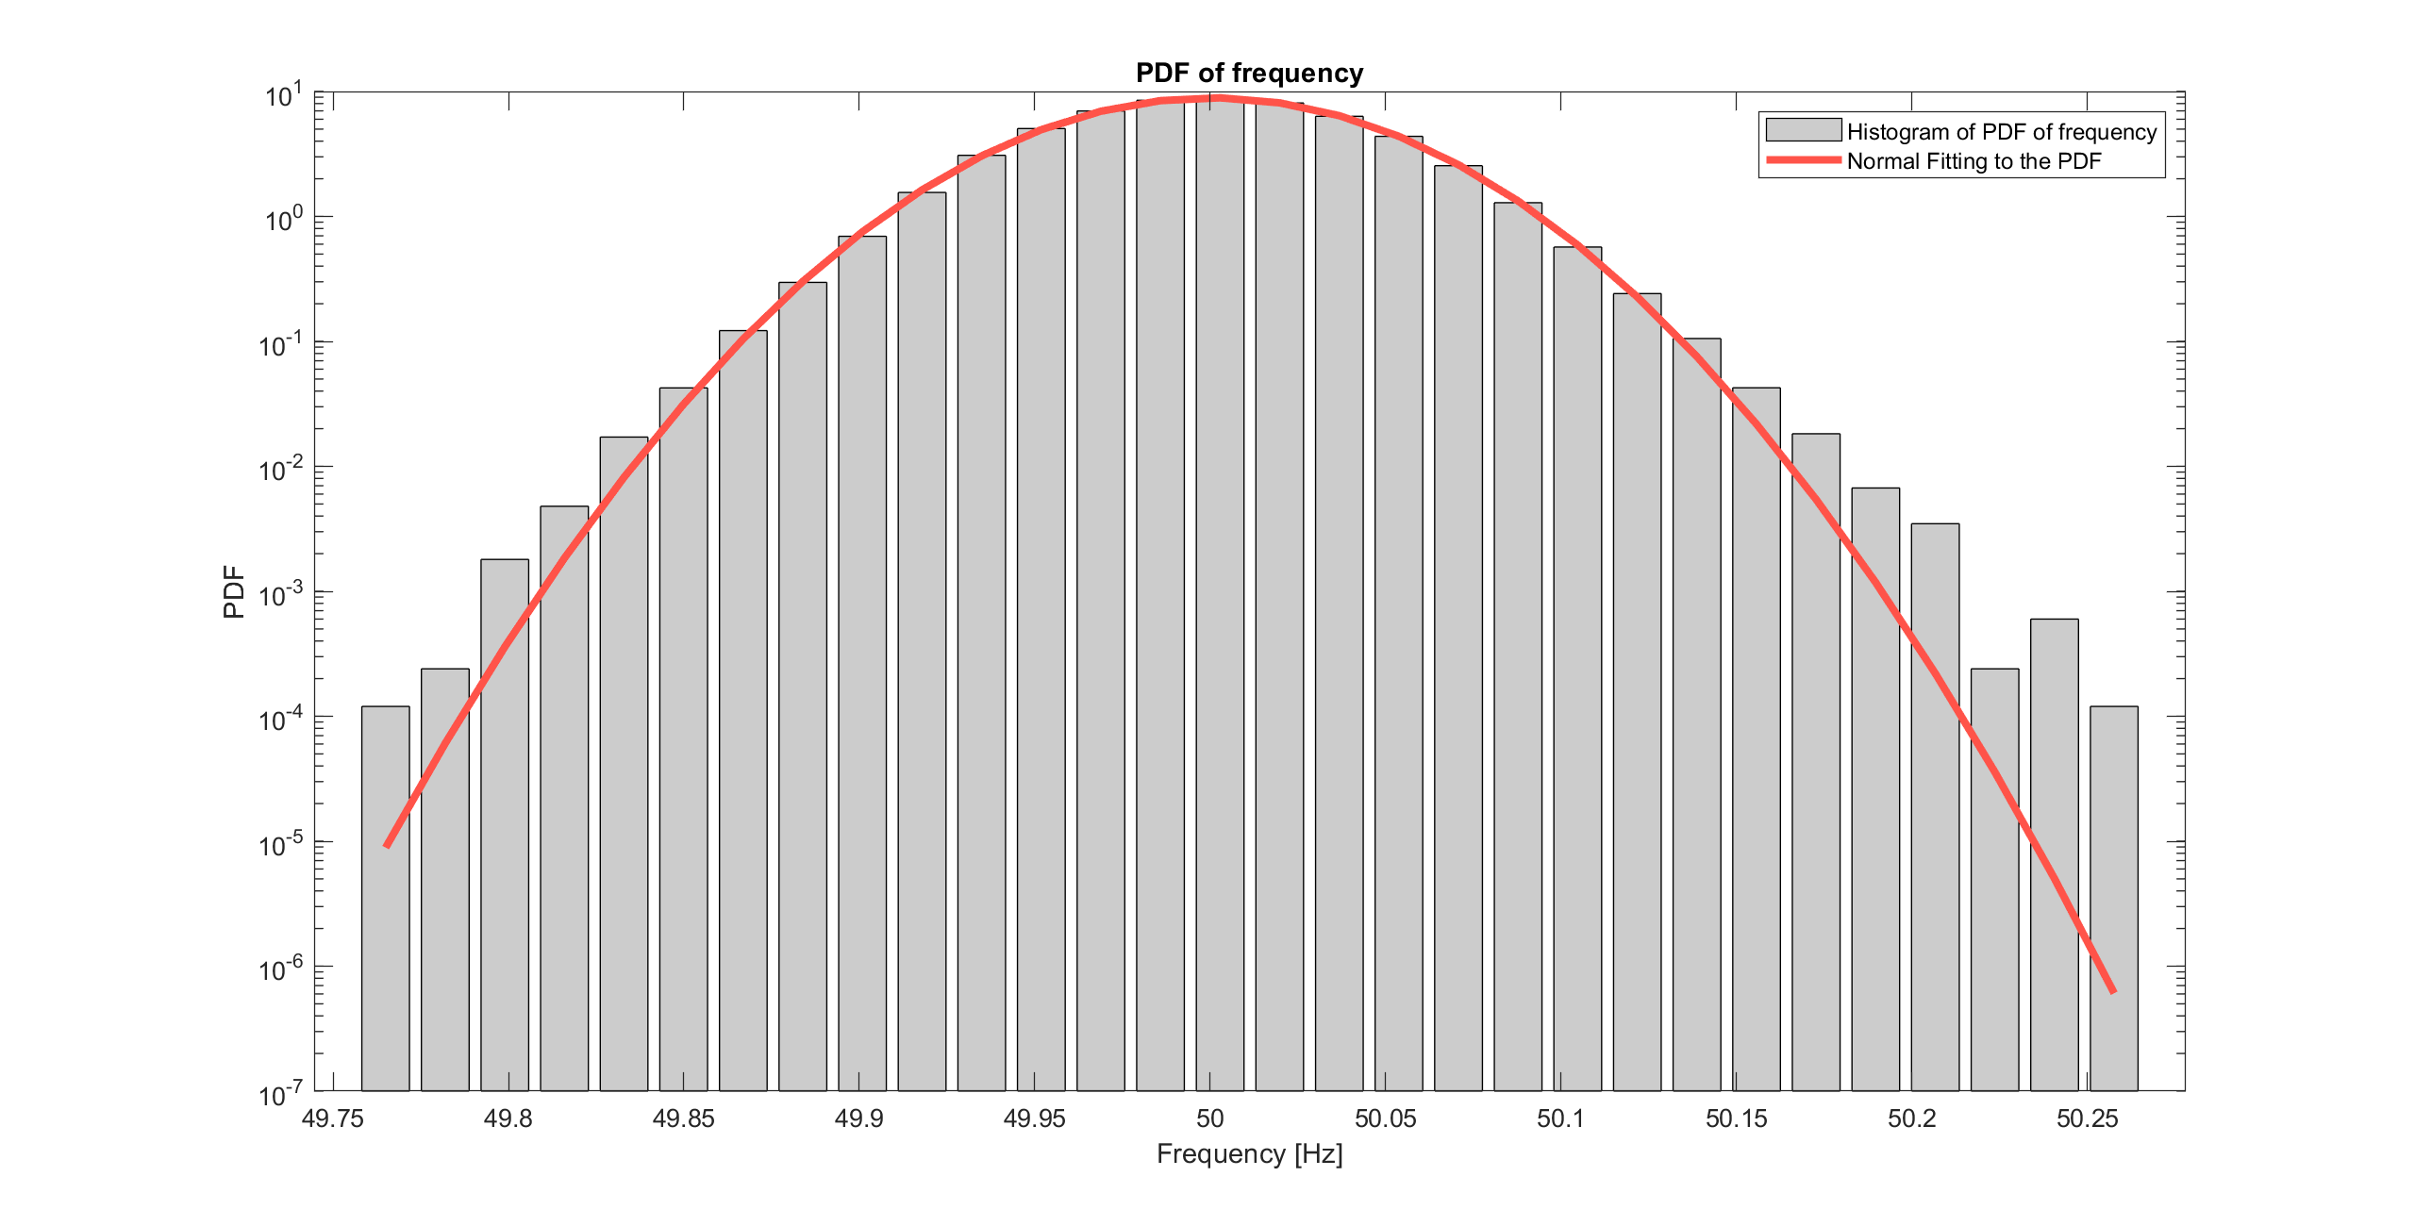
Offline Analysis of Grid Frequencies from Various Parts of the World

Slide 30
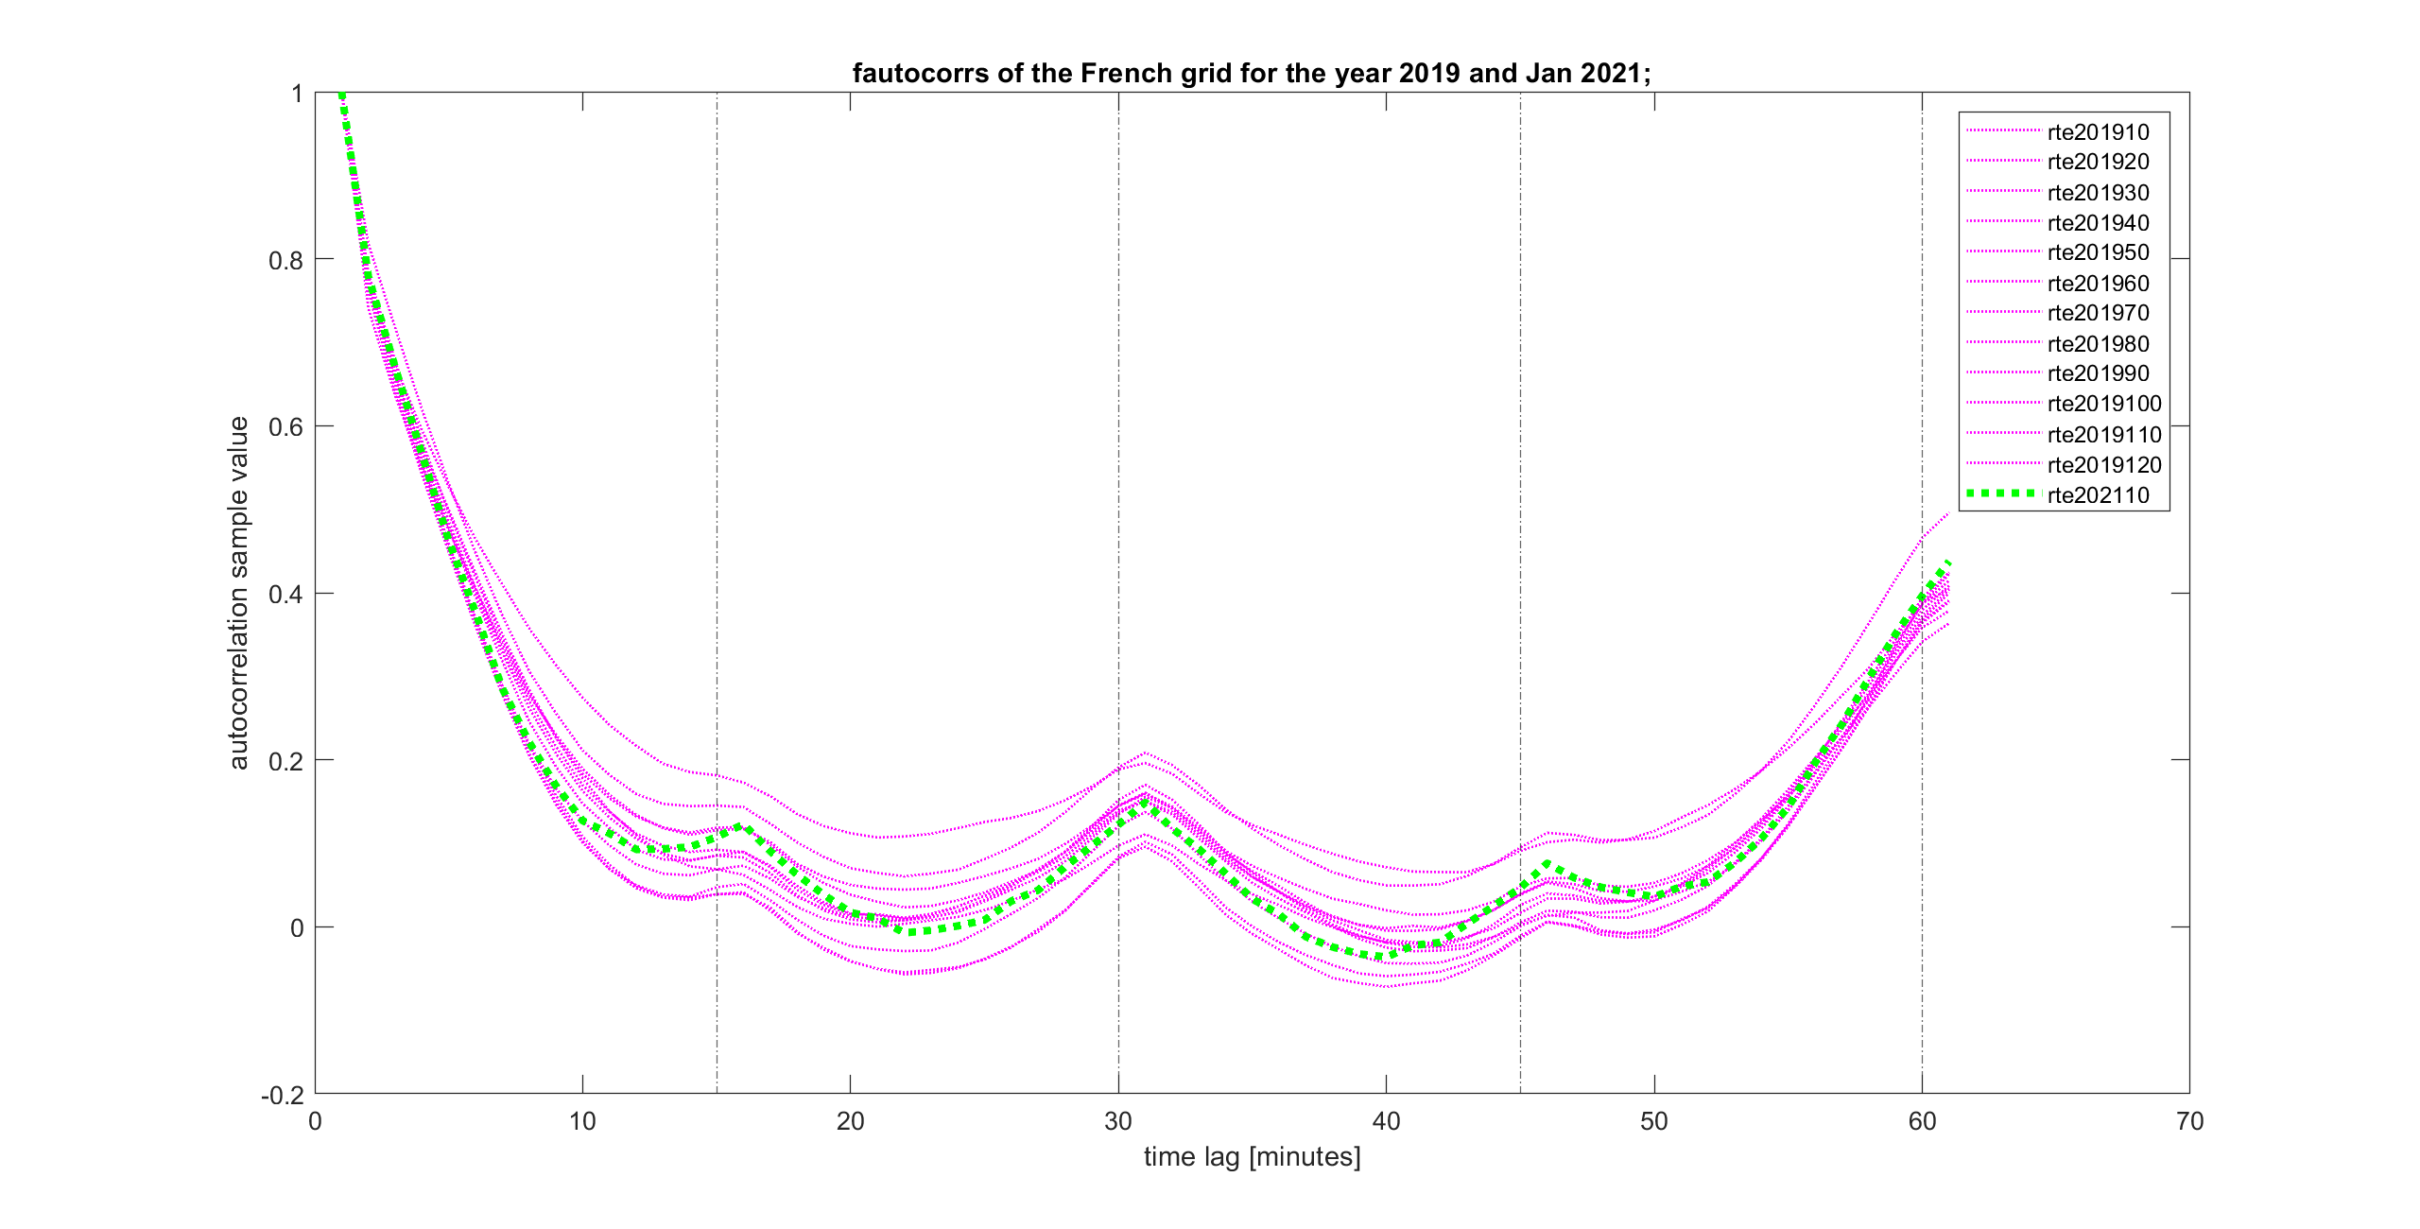
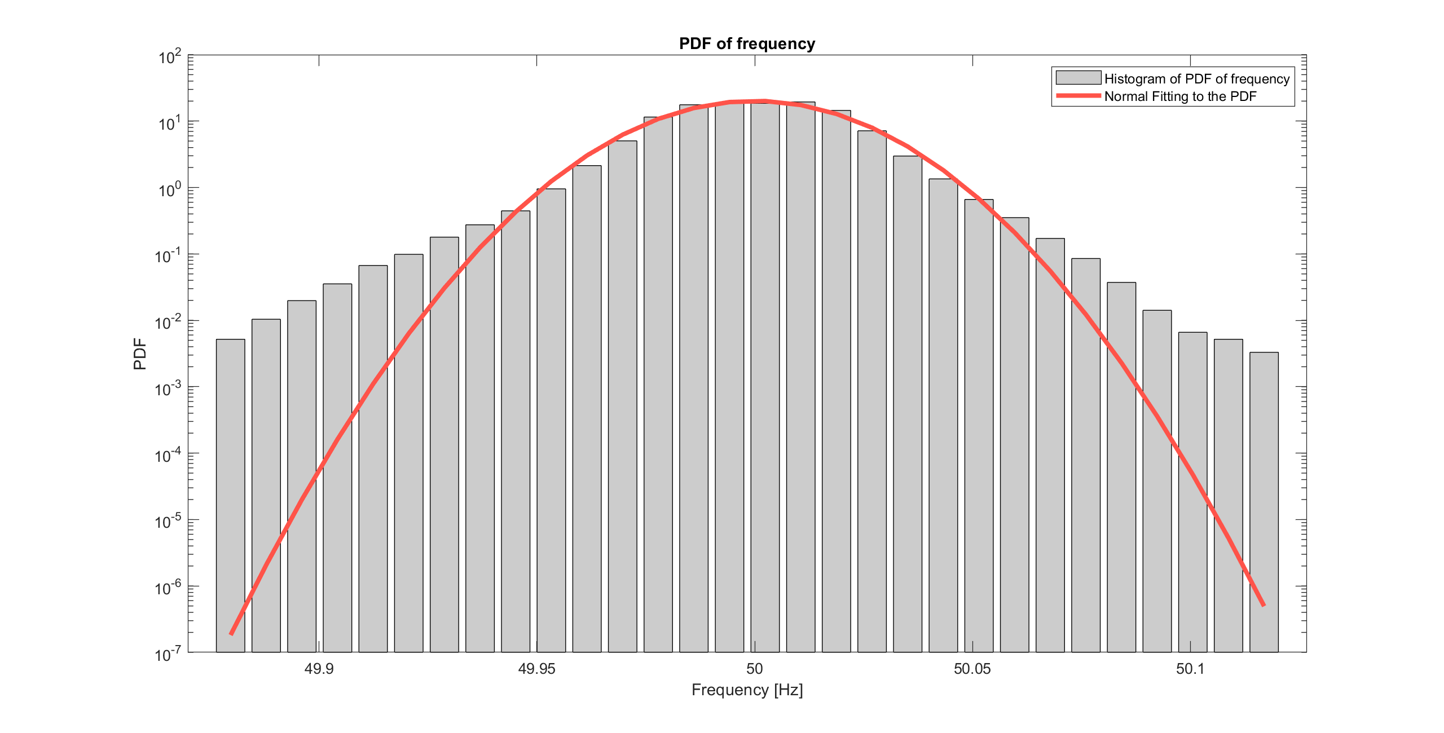
Offline Analysis of Grid Frequencies from Various Parts of the World

Slide 31
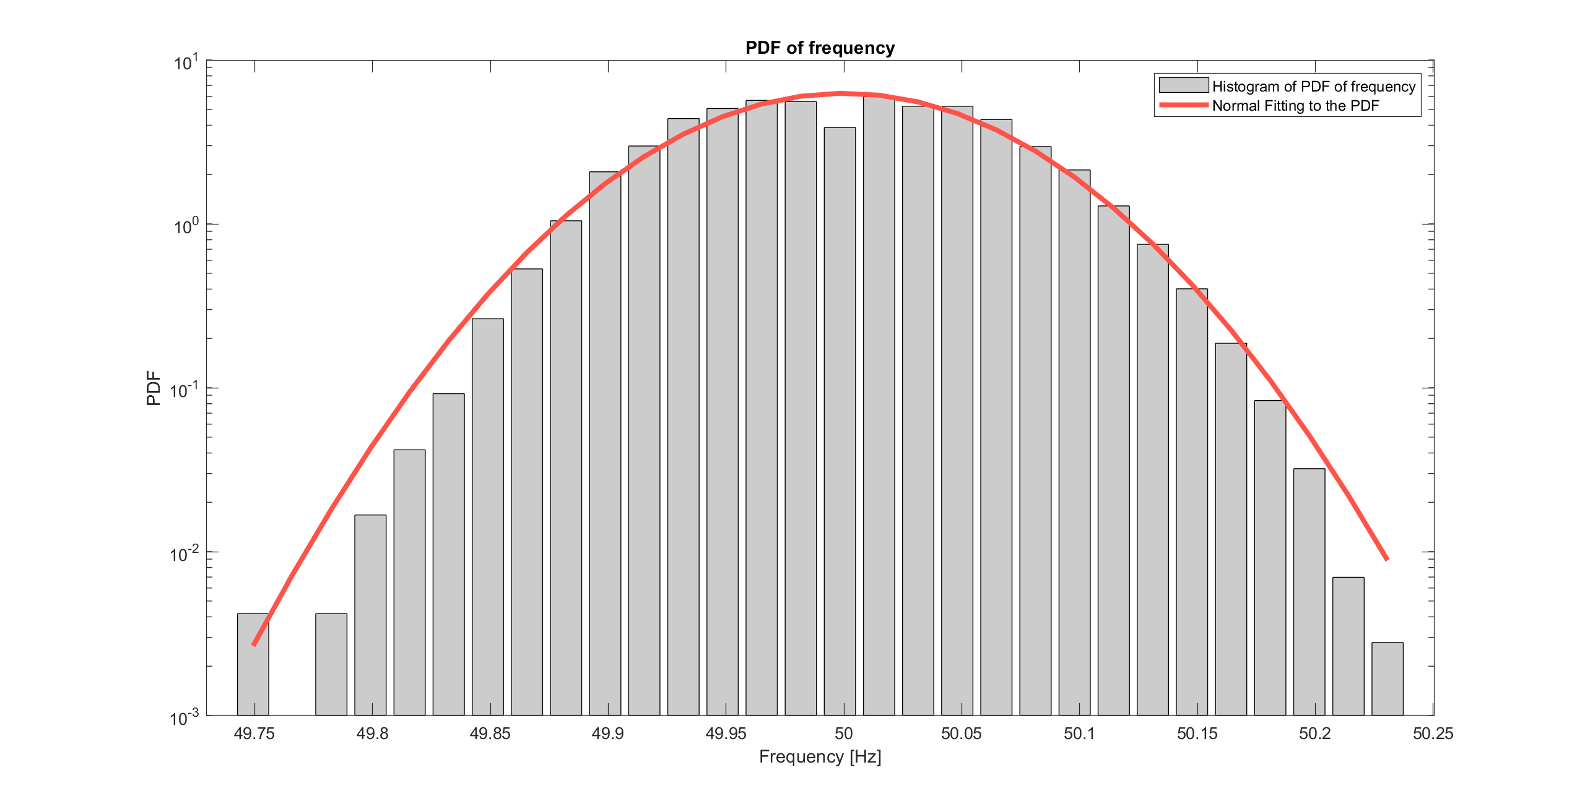


Offline Analysis of Grid Frequencies from Various Parts of the World

Slide 32

Offline Analysis of Grid Frequencies from Various Parts of the World

Slide 33


Online Analysis of Bus Voltages and Branch Currents for a Test IEEE $9$ Bus System

Slide 34

Online Analysis of Bus Voltages and Branch Currents for a Test IEEE $9$ Bus System

